Slide 1
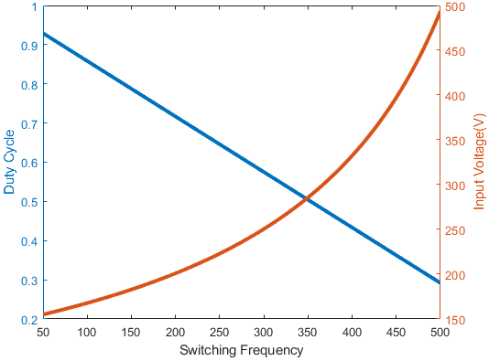


Inductor Loss Considerations
Aim: To investigate temperature rise of inductor w.r.t. switching frequency under constant current ripple
Outcome: There will be a temperature vs frequency plot at the end of this test
Conditions: ΔI = 30App L = 6.8uH
Rload = 24 Ω
Iout = 6A
Vout = 144V
Pout = 864W
$$D=1−\frac{L∗f_{sw}∗δI}{V_{out}}$$
$$V_{inp}=\frac{V_{out}}{D}$$

